Slide 1

Presentation on
COLLEGE ERP SYSTEM
Project (PCA20P03L) by
Jatin Sharma
(RA2132241030008)
Under The Supervision of - Dr Rajeev Sharma Sir
Department of Computer Applications
SRM Institute of Science & Technology
NCR Campus, Modinagar
Delhi-Meerut Road, Sikari Kalan, Modinagar–201204, GHAZIABAD (U.P.)

Slide 2
Introduction
The objective of College Information Management System is to allow the administrator of any organization the ability to edit and find out the personal details of a student and allows the student to keep up to date his profile. It’ll also facilitate keeping all the records of students, such as their id, name, mailing address, phone number, DOB etc. So all the information about a student will be available in a few seconds. Overall, it’ll make Student Information an easier job for the administrator and the student of any organization.
The main purpose of this project is to illustrate the requirements of the project College Information Management System and is intended to help any organization to maintain and manage personal data. This reduces data error and ensures that information is always up-to-date throughout the college. It provides a single source of data repository for streamlining your processes and for all reporting purposes.
Presented by: Jatin Sharma (RA2132241030008) , Deptt. of Computer Applications

Slide 3
Aim of the problem
As we know that, a college consists of different departments, such as course departments, fees management, library, event management etc. Nowadays applications and uses of information technologies is increased as compared to before, each of these individual departments has its own computer system to do their own functionalities. By having one main system they can interact with each other from their respected system by having valid user id and password.
The objective of College Information Management System is to allow the administrator of any organization the ability to edit and find out the personal details of a student and allows the student to keep up to date his profile. It’ll also facilitate keeping all the records of students, such as their id, name, mailing address, phone number, DOB etc. So all the information about a student will be available in a few seconds. Overall, it’ll make Student Information an easier job for the administrator and the student of any organization.
Presented by: Jatin Sharma (RA2132241030008) , Deptt. of Computer Applications

Slide 4
Tools & Technologies Used :
Database: MySQL database
Front end: HTML/CSS/Bootstrap
Back end: Django
Presented by: Jatin Sharma (RA2132241030008) , Deptt. of Computer Applications

Slide 5
Task Assigned
The Project schedule activities will consist of following:
Selecting The Project Title
System Requirement Collection
System Design
Acquiring the required resources
Coding
Testing of the Application
Deployment
Presented by: Jatin Sharma (RA2132241030008) , Deptt. of Computer Applications

Slide 6
Advantages
Streamlined Processes: College ERP system can streamline various administrative tasks such as student admissions, fee payments, scheduling, attendance management, library management, and more, by automating these tasks and making them easily accessible from a centralized system.
Improved Communication: With a college ERP system, communication between students, faculty members, and administrative staff can be improved through a common platform. This can help in facilitating better collaboration, feedback, and support among stakeholders.
Enhanced Security: College ERP system can provide a high level of security and privacy for sensitive information such as student records, financial data, and academic records. Access to this information can be controlled by authorized users and security features such as password protection, firewalls, and encryption can be implemented.
Increased Efficiency: College ERP system can automate various tasks, reduce manual data entry, eliminate errors and delays, and provide real-time data updates. This can help in increasing the overall efficiency of administrative tasks.
Presented by: Jatin Sharma (RA2132241030008) , Deptt. of Computer Applications

Slide 7
Disadvantages
Implementation Cost: The implementation cost of a college ERP system can be high, including the cost of software, hardware, and customization, training, and support. This can be a significant financial burden for some institutions.
Technical Issues: College ERP system can face technical issues such as software bugs, hardware failures, and network issues. These issues can cause system downtime and disruption in operations, which can impact the overall performance of the institution.
Security Risks: College ERP system can pose security risks such as data breaches, hacking, and cyber attacks. This can cause the loss of sensitive data, financial loss, and reputational damage.
User Dependency: College ERP system can be dependent on user input and interaction for the accuracy of data and the proper functioning of the system. This can lead to errors and inconsistencies if users are not properly trained or are not using the system correctly.
Presented by: Jatin Sharma (RA2132241030008) , Deptt. of Computer Applications

Slide 8
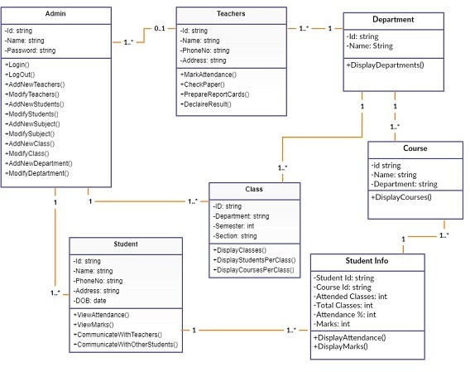
Class Diagram
Presented by: Jatin Sharma (RA2132241030008) , Deptt. of Computer Applications

Slide 9
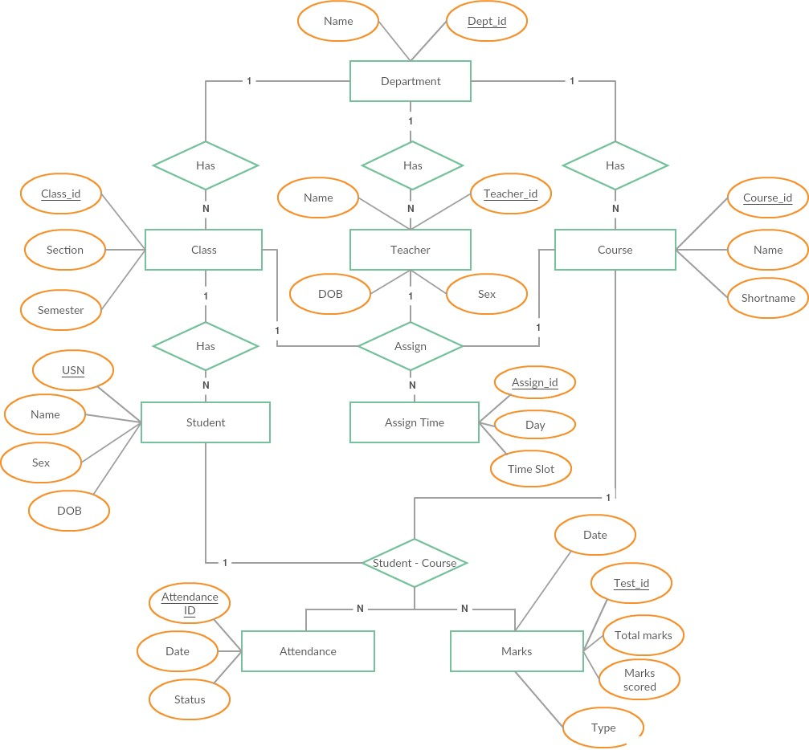
Entity Relationship Diagram
Presented by: Jatin Sharma (RA2132241030008) , Deptt. of Computer Applications

Slide 10
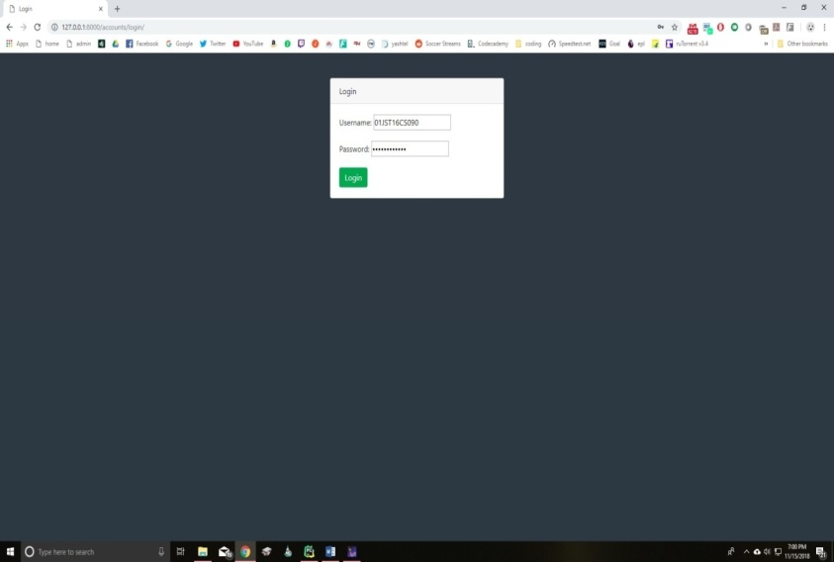
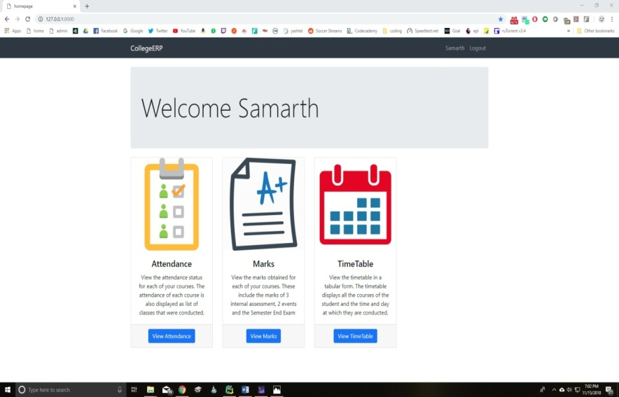
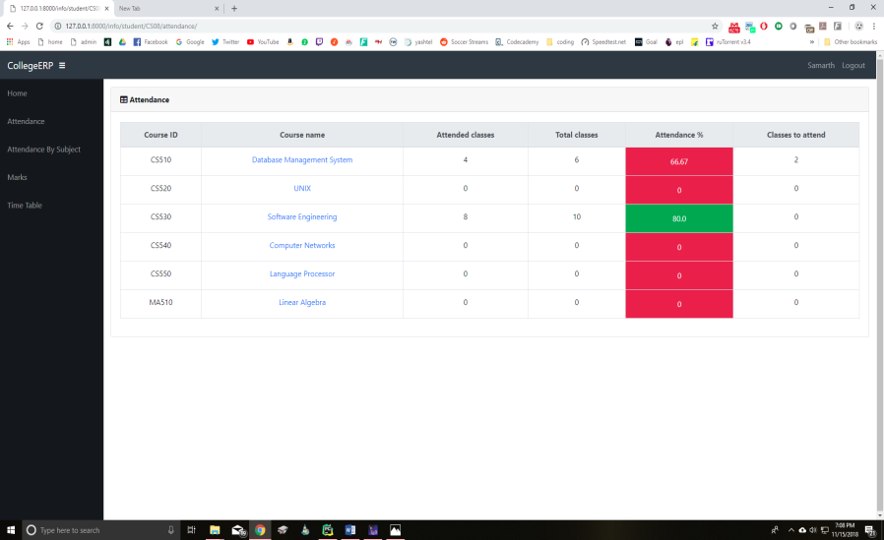
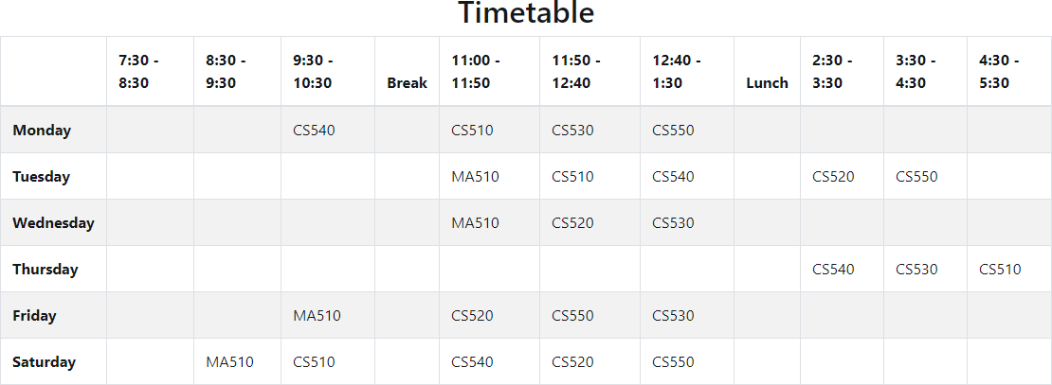
Screenshots
Presented by: Jatin Sharma (RA2132241030008) , Deptt. of Computer Applications

Slide 11
References
Elmasri and Navathe: Fundamentals of Database Systems, 7th Edition, Pearson Education, 2016.
Ian Sommerville: Software Engineering, 10th edition, Person Education Ltd, 2015.
Roger S Pressman: Software Engineering- A Practitioners approach,8th edition, McGraw-Hill Publication, 2015.
https://en.wikipedia.org/wiki/Requirements-engineering
https://web.cs.dal.ca/ hawkey/3130/srs-template-ieee.doc
http://www.ntu.edu.sg/home/cfcavallaro/Reports/Report%20writing.htmTop
https://en.wikipedia.org/wiki/Class diagram
https://www.djangoproject.com/
https://getbootstrap.com/
https://www.tutorialspoint.com/
https://creately.com/
Presented by: Jatin Sharma (RA2132241030008) , Deptt. of Computer Applications

Slide 12
Thank You..!

